Slide 1
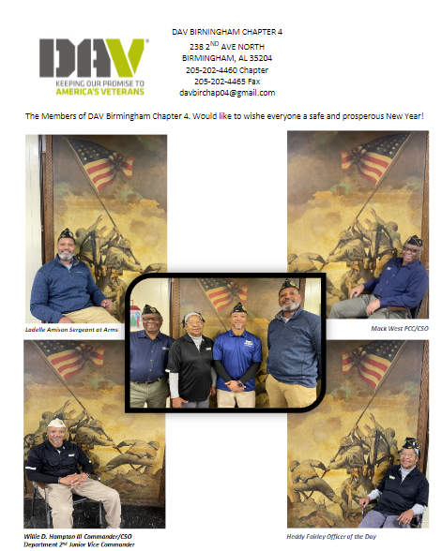

Slide 2


Senior Vice Commander
The role of the Senior Vice Commander in a DAV Chapter.
Notes:
The senior vice commander is obviously the 2nd in command but other than covering for the commander when he/she can’t make a meeting what does the senior vice actually do?

Slide 3
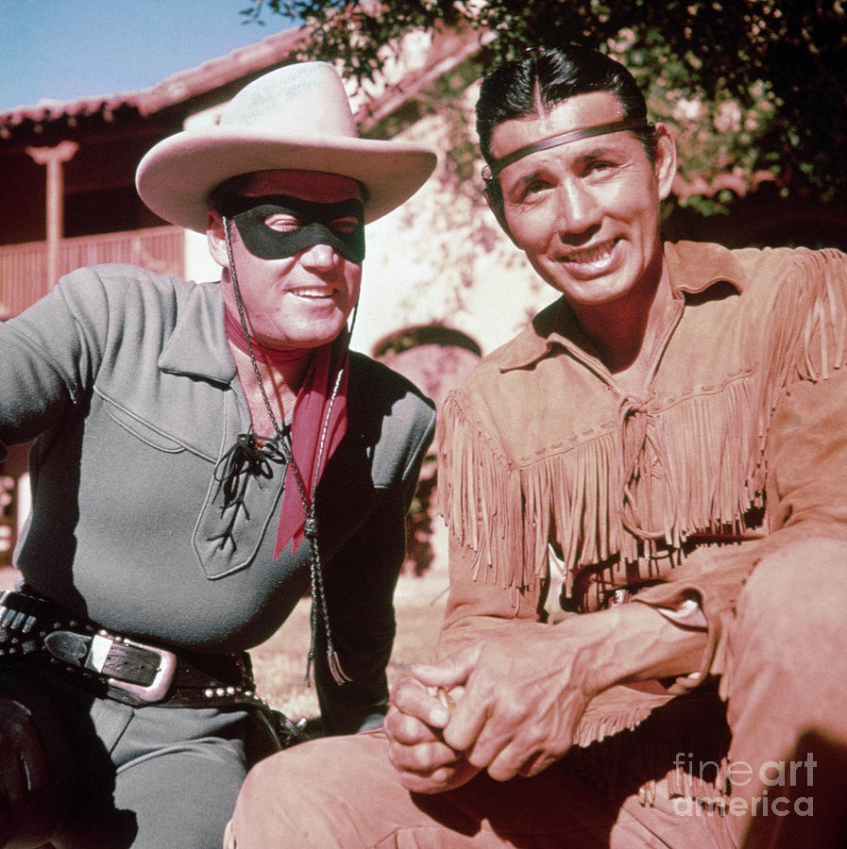
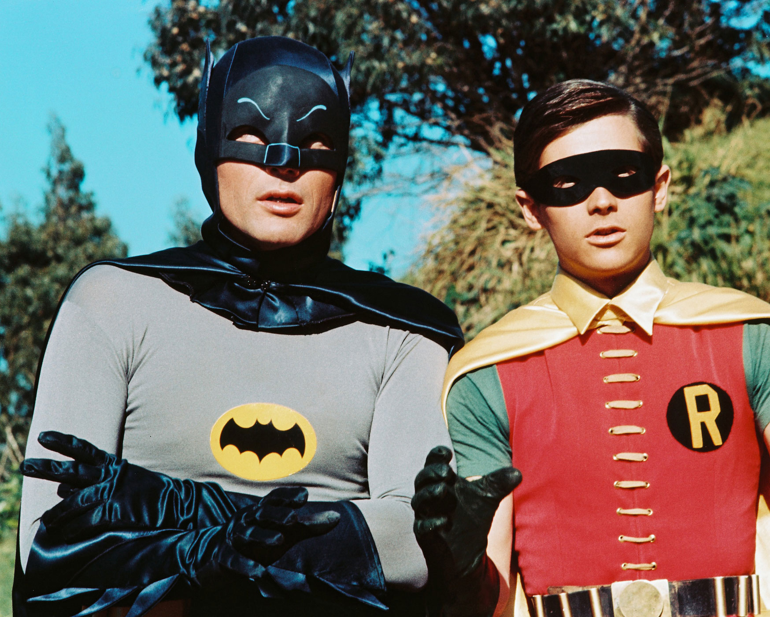
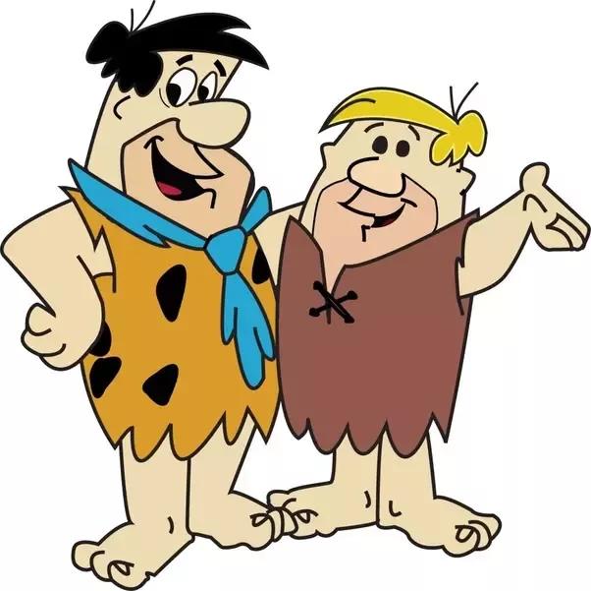
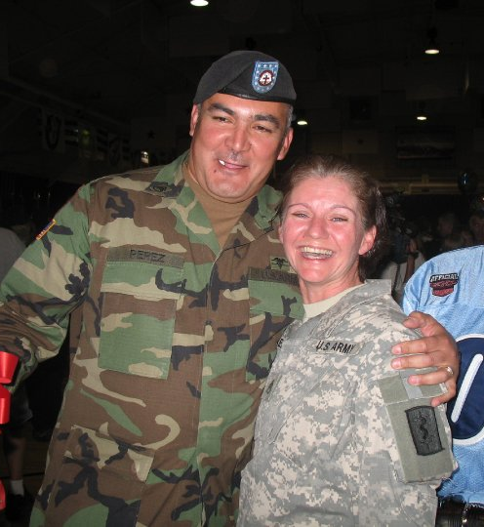
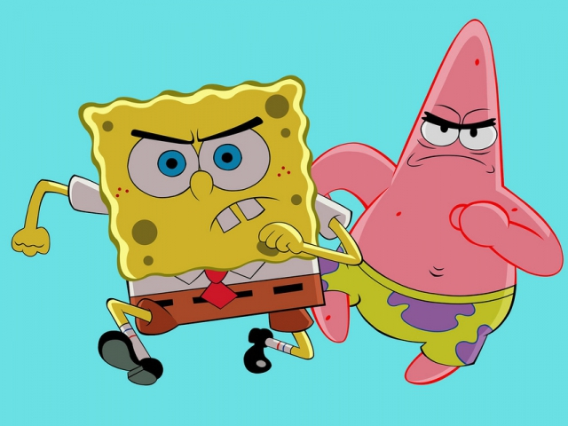
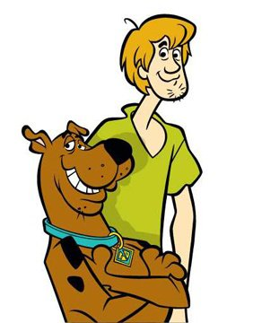
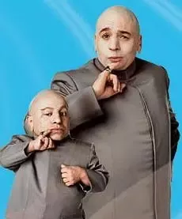
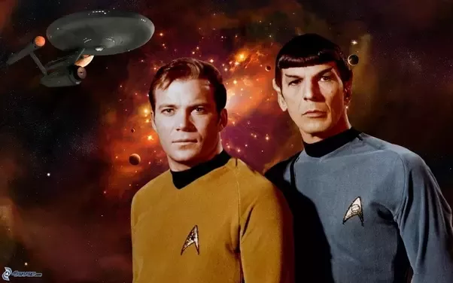
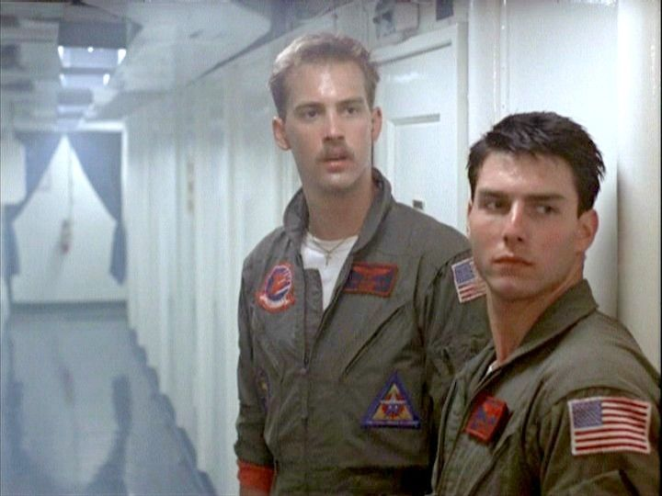
The Sidekick
Notes:
Senior vice could mean the assistant commander, the backup, a deputy, maybe even the first officer. I like to think of the senior vice as the commander’s sidekick. Every superhero needs a sidekick don’t ya think??
A sidekick is a slang expression for a close companion or colleague who is, or is generally regarded as, subordinate to the one they accompany. Sidekicks can fulfill one or multiple functions, such as a counterpoint to the hero, an alternate point of view, or knowledge, skills, or anything else the hero does not have. With these couple of sentences from Wikipedia I like this term even more. The sidekick completes the dynamic duo. Sometimes the best ideas are collaborations of different points of view woven together with a little give and take.

Slide 4
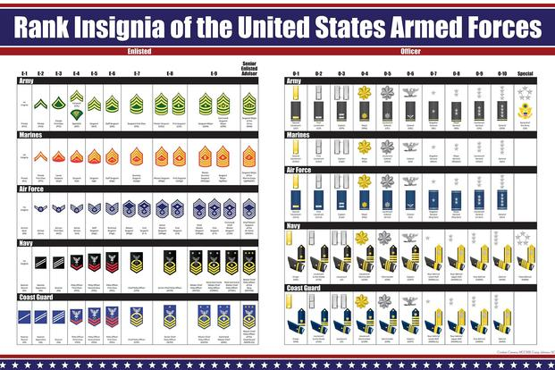
In military terms
Notes:
In a military context, the chain of command is the line of authority and responsibility along which orders are passed within a military unit and between different units. In simpler terms, the chain of command is the succession of leaders through which command is exercised and executed. In this volunteer organization that we serve in there isn’t really a chain of command, but we use similar terms to maintain the structure that many of us are comfortable with. Being an Army Veteran I am familiar with the company commander and 1SG, the battalion commander and the SGM, the brigade commander and the CSM. In these instances, I guess the enlisted rank would be the adjutant in our DAV, but every commander needs a good XO.

Slide 5
The senior vice commander shall perform the duties of his/her station as set forth in the Official DAV Ritual. He/she shall encourage friendship among the members of this organization, discourage discord and promote harmony. Subject to the direction of the chapter, he/she shall act as chairperson of membership solicitation activities to the end that every eligible veteran may become a member. With the approval of the chapter, the senior vice commander may appoint one or more members to assist him/her in such membership activities. The senior vice commander may not serve as adjutant or treasurer.
As defined by DAV National in the Chapter Officer guide.
Notes:
If you’ve ever picked up a Chapter Officer guide, then you’ve probably skimmed over this brief description of what a company senior vice is supposed to do. It isn’t very specific and there isn’t a lot to it. The Senior Vice is way more important than this one paragraph.

Slide 6

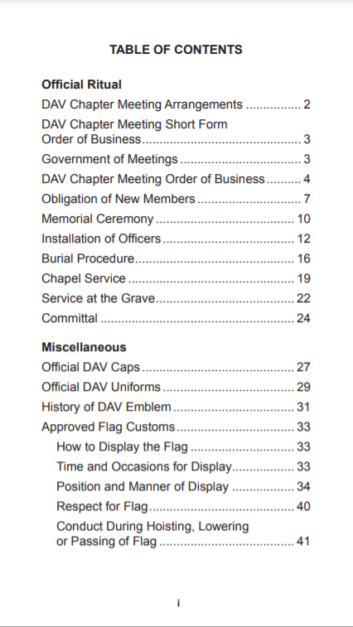
The senior vice commander shall perform the duties of his/her station as set forth in the Official DAV Ritual.
Senior Vice Commander is mentioned twice in this document
How to conduct chapter meetings
Special ceremonies such as installation of officers.
Important miscellaneous information that all members should be familiar with.
Notes:
I am breaking down each sentence of that very lengthy job description for a chapter senior vice commander. The first sentence refers us to the Official DAV Ritual handbook available through DAV.org. The senior vice is only mentioned twice in this entire document. It does detail how to conduct a chapter meeting. This makes it important to a new senior vice whose commander plays hooky early in his/her term. Unless you’ve conducted a few meetings already you will most likely get lost, and this will keep you on track. It doesn’t expound on what a senior vice commander should do.

Slide 7
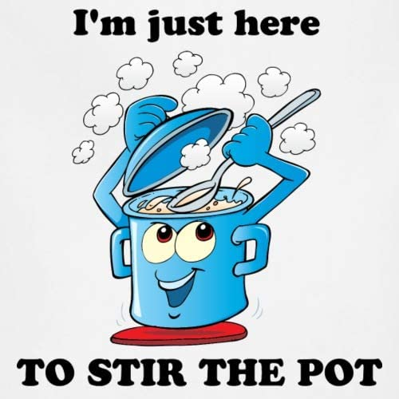
He/she shall encourage friendship among the members of this organization, discourage discord and promote harmony.
Be kind
Listen up
Open up
Show that you can be trusted
Make yourself available
Manage your nerves with mindfulness
https://www.mayoclinic.org/healthy-lifestyle/adult-health/in-depth/friendships/art-20044860
Notes:
This sentence, however, is very detailed. Who knew that the senior vice commander is the one who is supposed to encourage friendship, discourage discord and promote harmony?? I like lists so I borrowed a short one from mayoclinic.org to help with this one. To encourage friendship, one should be kind…… to everyone; listen up and allow each member to express their ideas or concerns; open up and share a little about yourself; show that you can be trusted by not sharing negative feelings or gossip about a fellow member; make yourself available by returning phone calls, texts or emails; manage your nerves with mindfulness…. Not like I did a couple of years ago when I was up here in the hot seat for the first time. Be the calm in the storm. Help squash arguments among members during meetings. Discourage conversations that instigate anger. Be the “Can’t we all just get along” guy. Don’t be this guy!

Slide 8
Subject to the direction of the chapter, he/she shall act as chairperson of membership solicitation activities to the end that every eligible veteran may become a member. With the approval of the chapter, the senior vice commander may appoint one or more members to assist him/her in such membership activities.
Membership
Learn everything so that you can teach (online application, cost, eligibility)
Make yourself familiar with the online membership system (CRM)…… when it’s back online
Keep the commander informed on membership status
Coordinate membership drives
Be prepared to tell Veterans what’s in it for them
Create recruiting challenges within your chapter with incentives
Check occasionally for deceased members

Slide 9

What else can a Senior Vice Commander do??
Elected yearly
Is a member of the executive committee
In the event the office of Commander shall be vacated for any reason, the Senior Vice Commander shall be elevated to Commander
Cannot serve as chapter treasurer
Cannot serve on audit committee
Notes:
Since you’re organizing recruiting events why not piggyback a fundraiser with it? Teach, teach, teach! Teach anyone who has a willingness to learn.

